Slide 1

Notes:
This should be the title slide for all corporate presentations pertaining to the overall university level

Slide 2

Faculty of Engineering and Technology
Department of Computer Science and Design
Notes:
This is the title slide for respective colleges/institutions while we retain the DMIHER logo on top always.

Slide 3

Presentation for Major Project II

Slide 4
Deep Learning based detection of various dental anomalies using Orthopantomogram
NAME OF STUDENT: SAKSHI VIJAY IZANKAR
NAME OF THE SUPERVISOR: MR. CHETAN PURI
DEPARTMENT OF COMPUTER SCIENCE AND DESIGN,
FACULTY OF ENGINEERING AND TECHNOLOGY, SAWANGI (MEGHE), WARDHA
DATE :29/02/2025

Slide 5
CONTENTS
Introduction
Prisma Chart
Prisma-S Extension
Knowledge /Research gap analysis
Knowledge/Research Gap Summary
Nature of the Knowledge Gap Identified
Research Question
Aim
Objectives
Methodology
Quarterly Scheduling of Research Work
Publication Schedule
References

Slide 6
INTRODUCTION
Dental anomalies are a significant concern in oral healthcare, affecting individuals worldwide and leading to various complications if left undiagnosed.
These anomalies can result from genetic, developmental, or environmental factors, impacting tooth structure, alignment, and overall oral health. Early and accurate detection is crucial for timely intervention and treatment planning.
Orthopantomogram (OPG) imaging plays a vital role in diagnosing dental anomalies, as it provides a comprehensive view of the entire dentition, jaw structure, and surrounding tissues.
This project leverages deep learning techniques, including YOLO, Faster R-CNN, and SSD, to analyze OPG images and detect various dental anomalies effectively.
By utilizing AI-powered automation, this approach enhances diagnostic accuracy, reduces human error, and supports dentists in making informed clinical decisions, ultimately improving patient outcomes and advancing dental healthcare.

Slide 7
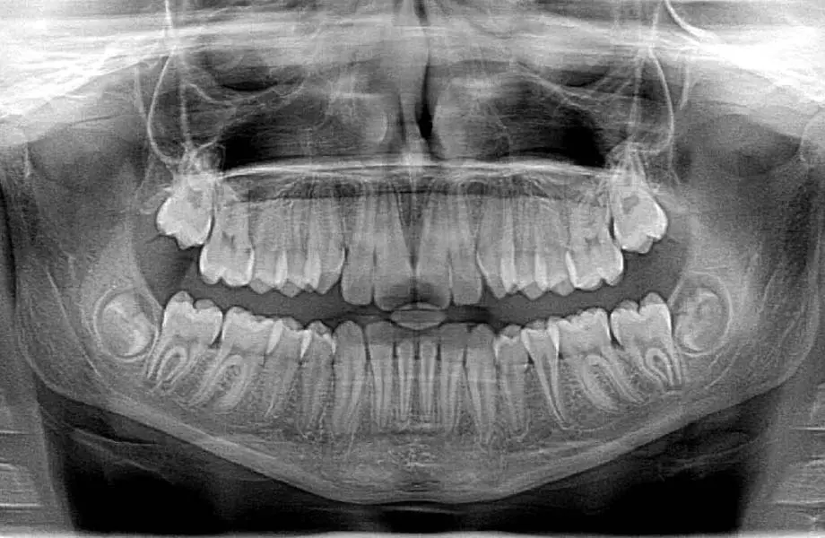
INTRODUCTION
YOLO (You Only Look Once) is used for real-time detection with a balance of speed and accuracy.
Faster R-CNN is implemented for its high accuracy in detecting detailed patterns in medical images.
SSD (Single Shot MultiBox Detector) provides efficient real-time detection with lower computational needs.
Fig. 1. Dental X-ray Image

Slide 8
SYSTEMATIC REVIEW OF LITERATURE (PRISMA FLOW DIAGRAM)
Identification
Articles identified through other sources SCIE/SCOPUS/Research Gate Sources (n=10)
Articles identifies through IEEE searching (n=20)
Records after duplicates removal (n=20)
Screening
Records screened for removal(n=2)
Article excluded:(n=18)
Records excluded(n=3)
Full text articles excluded with reasons: Objective is not matching.
Number of Full text articles assessed for eligibility (n=18)
Eligibility
Original articles-5
Review articles-8 Met analysis & SR-0
RCT-0
Books-2
Included
Number of Studies included in Qualitative and Quantitative (n=15)

Slide 9
PRISMA-S EXTENSION
Topic | Item | Checklist item
Data base name | 1 | Dental X-ray Dataset
Registries | 2 | N/A
Search strategies | 4 | Dental Caries, Dental Radiography, Artificial Intelligence, Machine Learning, Image Interpretation, Computer-Assisted
Selection process | 5 | Identifying relevant mesh terms like Dental Radiography and Deep Learning. Prioritizing papers that explore deep learning models like CNNs, data preprocessing methods, and clinical validation.
Limits and restrictions | 6 | Prominence is given to studies conducted within the last 5 years to ensure relevance and accuracy. Studies older than this period are included only to provide historical context and foundational knowledge.
Search filters | 7 | Research on dental caries detection using X-ray images. Applications of deep learning models such as CNNs and transfer learning. Studies comparing traditional diagnostic methods with AI-based approaches.
Total records | 8 | Journal articles, Research articles. 15 total records

Slide 10
RESEARCH ARTICLES INCLUDED
Sr. No | Type of article | Total
1 | Original Article | 5
2 | SR & MA | -
3 | RCT | -
4 | Review | 8
5 | Books | 2
Grand Total | Grand Total | 15

Slide 11
KNOWLEDGE GAP
S. No. | Title of the Article Author Year of publication | Focus of Study, Design, Objectives , Method used and Sample size | Findings of the study and their conclusions | Remarks of the Scholar on limitations
1 | Validity of Digital Analysis versus Manual Analysis on Orthodontic Disease Malin Lam et al., 2024 Link | Focus: Comparison of digital and manual methods for orthodontic analysis. - Design: Quantitative study comparing methods. - Objectives: Assess reliability of digital analysis. - Method: Manual and digital cast analysis. - Sample size: 200 cases. | Found a high correlation between manual and digital methods. - Digital analysis reduced time and improved repeatability. | Limited sample diversity (only orthodontic cases). - Technology-specific biases not accounted for.
2 | Transfer Learning for Dental Disease Detection Johnson et al., 2023 Link | Focus: Explored transfer learning using pre-trained networks like ResNet. - Design: Experimental study with transfer learning. - Objectives: Leverage transfer learning for improved detection accuracy. - Method: ResNet-based transfer learning. - Sample size: 600 images. | Transfer learning improved accuracy by 10% compared to training from scratch. - Demonstrated potential of pre-trained models for dental X-ray analysis. | Pre-trained models may not adapt well to domain-specific features like dental anatomy. - Requires fine-tuning to specific datasets.

Slide 12
S. No. | Title of the Article Author Year of publication | Focus of Study, Design, Objectives , Method used and Sample size | Findings of the study and their conclusions | Remarks of the Scholar on limitations
3 | A Novel Deep Learning Model for Dental Leison Detection Smith et al., 2022 Link | - Focus: Evaluated CNN models for caries detection in panoramic X-rays. - Design: Experimental study using CNN architectures. - Objectives: Assess model performance in caries localization. - Method: CNN-based classification and segmentation. - Sample size: 500 X-ray images. | - Achieved 92% accuracy and localized caries in early stages. - CNNs outperformed traditional methods in caries detection. | - Limited dataset size resulted in reduced generalizability. - Validation on real-world clinical data needed for robustness
4 | Automatic Detection of Dental Caries Using YOLOv3 Lee et al., 2021 Link | Focus: Applied YOLOv3 for real-time dental caries detection. - Design: Comparative study with other object detection models. - Objectives: Evaluate YOLOv3 for rapid caries detection. - Method: Object detection with YOLOv3. - Sample size: 750 X-rays. | YOLOv3 achieved 85% precision and detected caries faster than other models. - Recommended YOLOv3 for real-time applications in clinical settings. | Model had difficulty detecting caries in overlapping tooth structures. - Limited interpretability for clinicians.

Slide 13
S. No. | Title of the Article Author Year of publication | Focus of Study, Design, Objectives , Method used and Sample size | Findings of the study and their conclusions | Remarks of the Scholar on limitations
5 | Image Preprocessing for Enhanced Tooth Disease Detection Patel and Singh, 2020 Link | Focus: Investigated impact of preprocessing (contrast adjustment, denoising) on detection accuracy. - Design: Experimental preprocessing pipeline. - Objectives: Optimize preprocessing for better model performance. - Method: Preprocessing + CNN. - Sample size: 300 images. | - Preprocessing improved detection accuracy by 7%. - Highlighted the importance of high-quality X-rays for deep learning-based detection. | - Preprocessing pipeline increased computation time. - Model performance depended heavily on preprocessing quality.
6 | YOLO-Based Caries Localization in Dental Radiographs Brown et al., 2020 Link | - Focus: CNN for precise caries localization. - Design: Object detection model with bounding boxes. - Objectives: Improve caries localization accuracy using YOLOv3. - Method: YOLOv3-based pipeline. - Sample size: 800 images. | - Improved localization precision by 15% compared to older YOLO versions. - Demonstrated suitability of YOLOv3 for high-speed analysis in clinical settings. | - Struggled with localization in poor-quality X-rays. - Needs integration with diagnostic workflows for better usability.

Slide 14
RESEARCH QUESTION
"How can deep learning techniques be utilized to accurately detect and classify various dental anomalies in Orthopantomogram (OPG) images?"

Slide 15
AIM
“To develop an AI-powered application utilizing deep learning techniques for the automated detection of dental anomalies in orthopantomogram (OPG) images, enabling accurate diagnosis and improving oral healthcare outcomes.”

Slide 16
OBJECTIVES
To develop an AI-powered application for the automated detection of dental anomalies using orthopantomogram (OPG) images.
To enhance diagnostic accuracy and efficiency through deep learning-based image analysis.
To assist dental professionals in early detection and treatment planning, improving patient outcomes.
To increase accessibility to AI-driven dental diagnostics, supporting better oral healthcare services.
16

Slide 17
METHODOLOGY
Data Collection and Preprocessing
Collect dental X-ray images from clinical sources or public datasets.
Preprocess images by resizing to the input dimensions required by YOLO V5s6, YOLO V5x6, YOLO V8, YOLO V9, SSD, and Faster R-CNN.
Apply data augmentation techniques like rotation, scaling, flipping, and contrast adjustments to improve dataset diversity.
Annotation of Dental Anomalies
• Collaborate with dental experts to annotate anomalies such as remainingroots, normal teeth, apical lesions, and cavities using bounding boxes.
• Create a high-quality labeled dataset with annotations representing the groundtruth for model training.
Model Selection and Implementation
Implement YOLO V5s6, YOLO V5x6, YOLO V8, YOLO V9, SSD, and Faster R-CNN for detection.
Use pre-trained weights for transfer learning and faster convergence.

Slide 18
METHODOLOGY
Performance Evaluation
Evaluate models using precision, recall, F1-score, and mean Average Precision (MAP) metrics.
Compare models’ ability to detect anomalies in challenging scenarios, such as overlapping teeth or small lesions.
Real-Time Detection Assessment
Measure each model’s inference time and speed to evaluate suitability for real-time clinical use.
Focus on balancing speed and detection accuracy.
Comparison and Selection
Analyze the performance of YOLO variants, SSD, and Faster R-CNN to identify the best-performing model(s).
Consider trade-offs in terms of precision, recall, and processing speed.

Slide 19
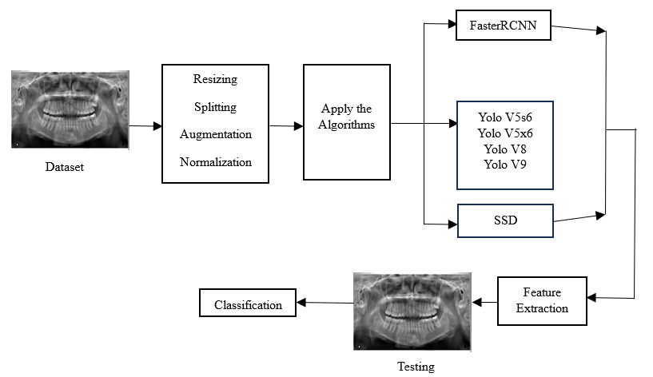
METHODOLOGY
Integration into Clinical Workflow
Develop a user-friendly interface to integrate the selected model into a clinical setting.
Allow dentists to upload X-rays, receive predictions, and visualize results for diagnostic support.
System Architecture

Slide 20
MATERIALS and METHOD
Phase 1: Deep learning based – Model development Algorithm: FasterRCNN, SSD, Yolo
Phase 2 : Application Development

Slide 21
Flowchart: Work Flow
Start
Import libraries
Yes
VERIFY
No
NO PROCESS
Importing the dataset- Dental Dataset
Data processing
Feature Selection
Splitting the data into train & test
Building the model – FasterRCNN, YOLO
Training the model
Click the Picture
Select the points
Final outcome
End process

Slide 22
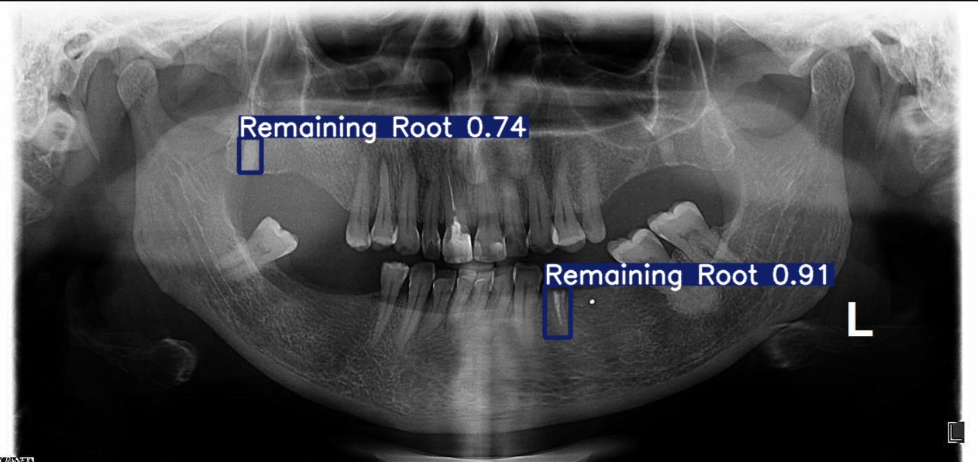
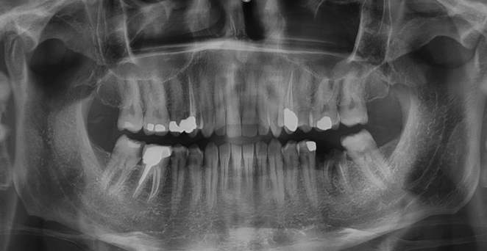
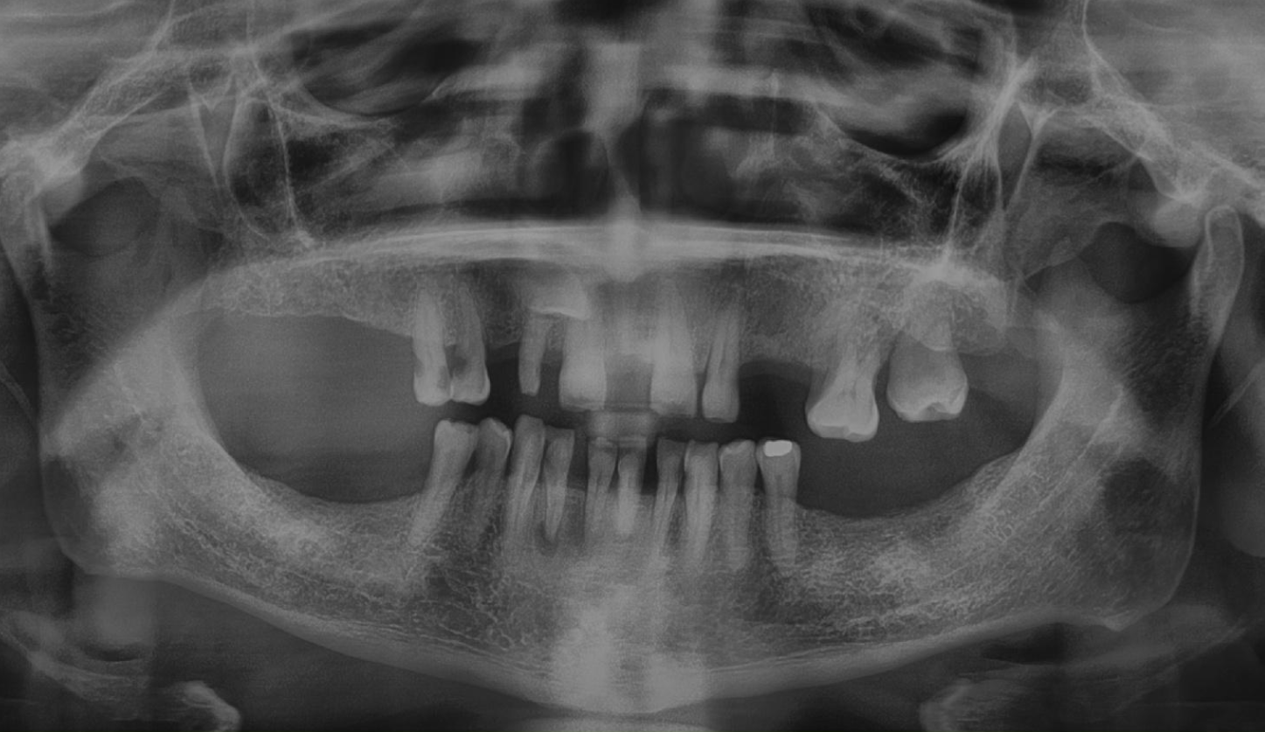
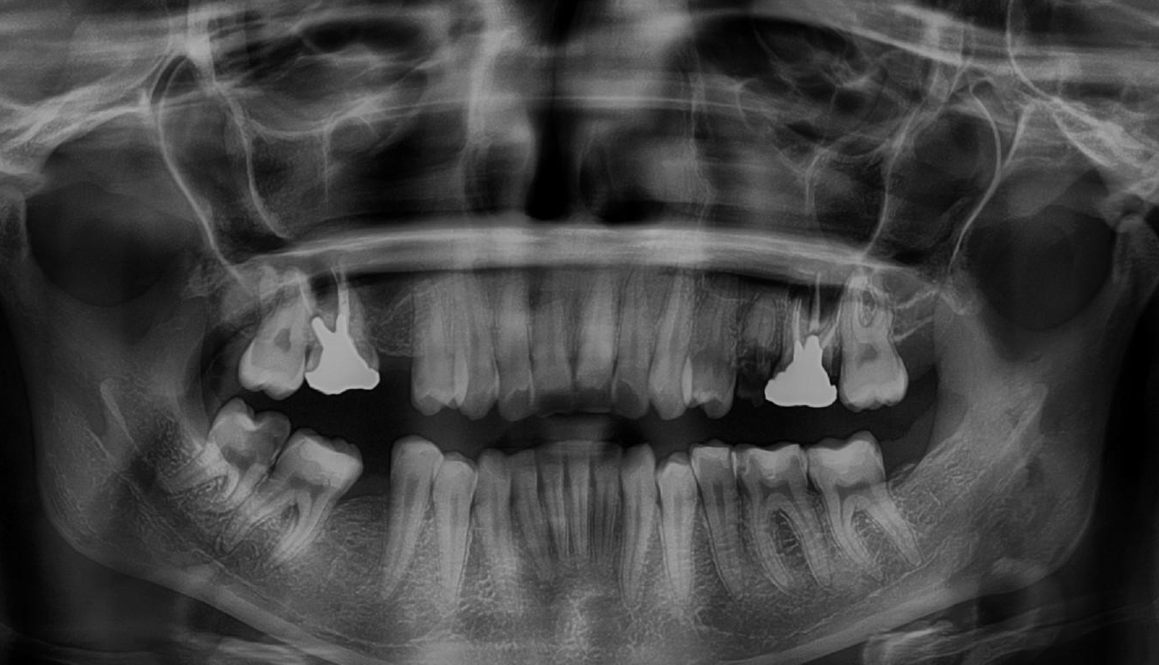
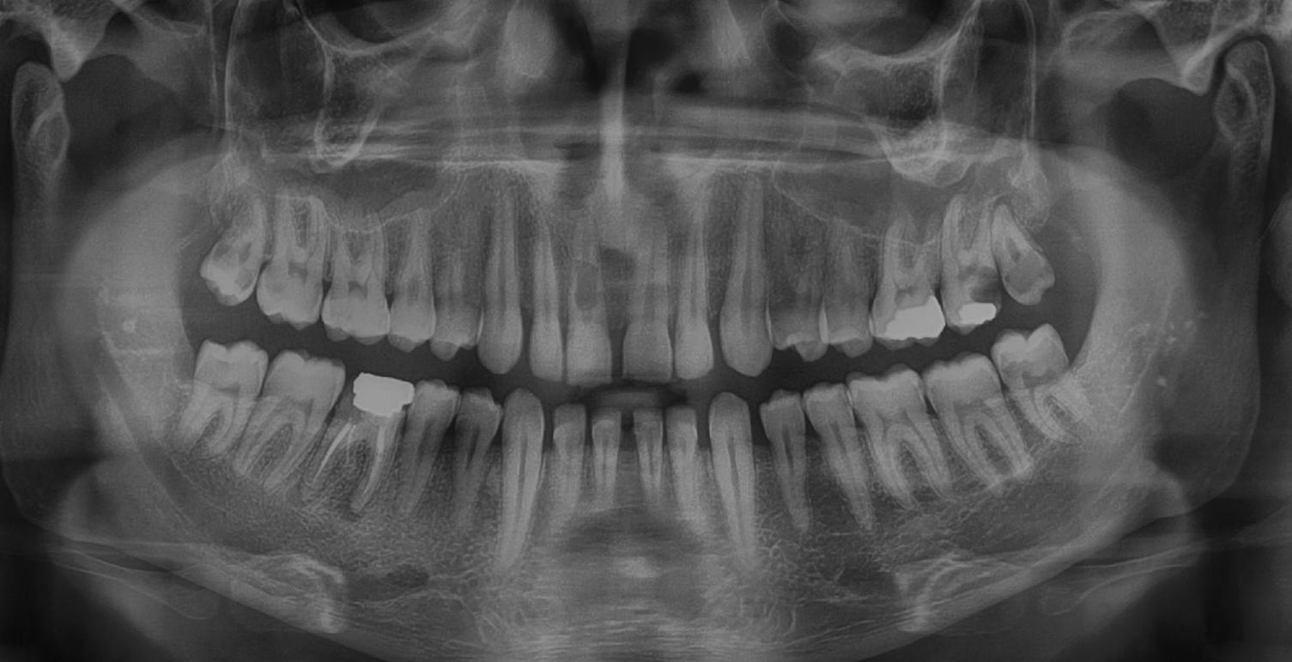
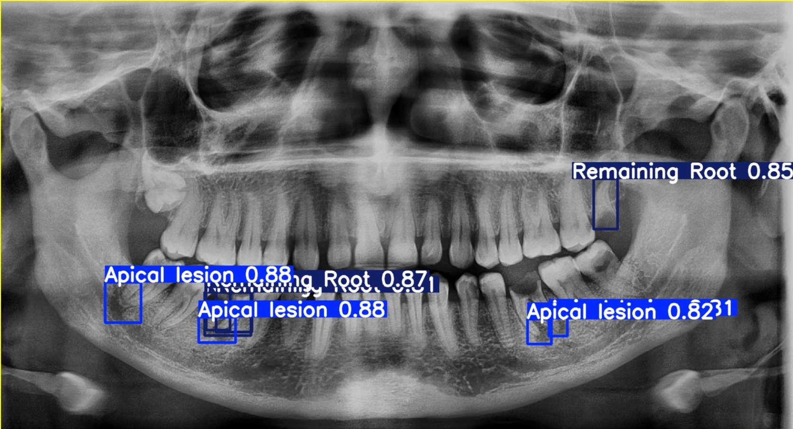
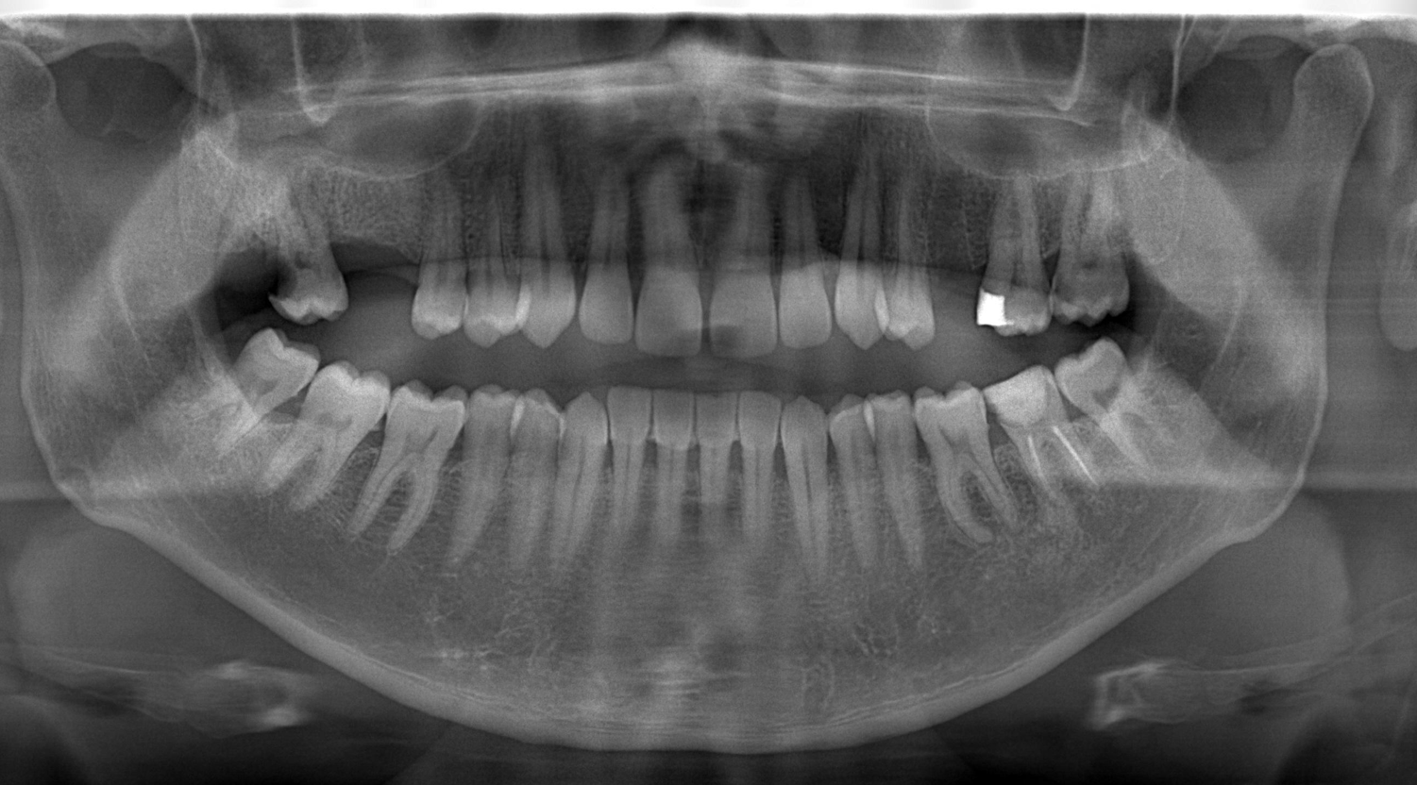
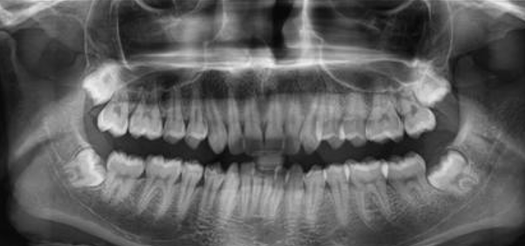
Progress
Predicted Output
Dataset: Dental X-Ray Images
(a)
(b)
Fig. Dental Anomalies Detection

Slide 23
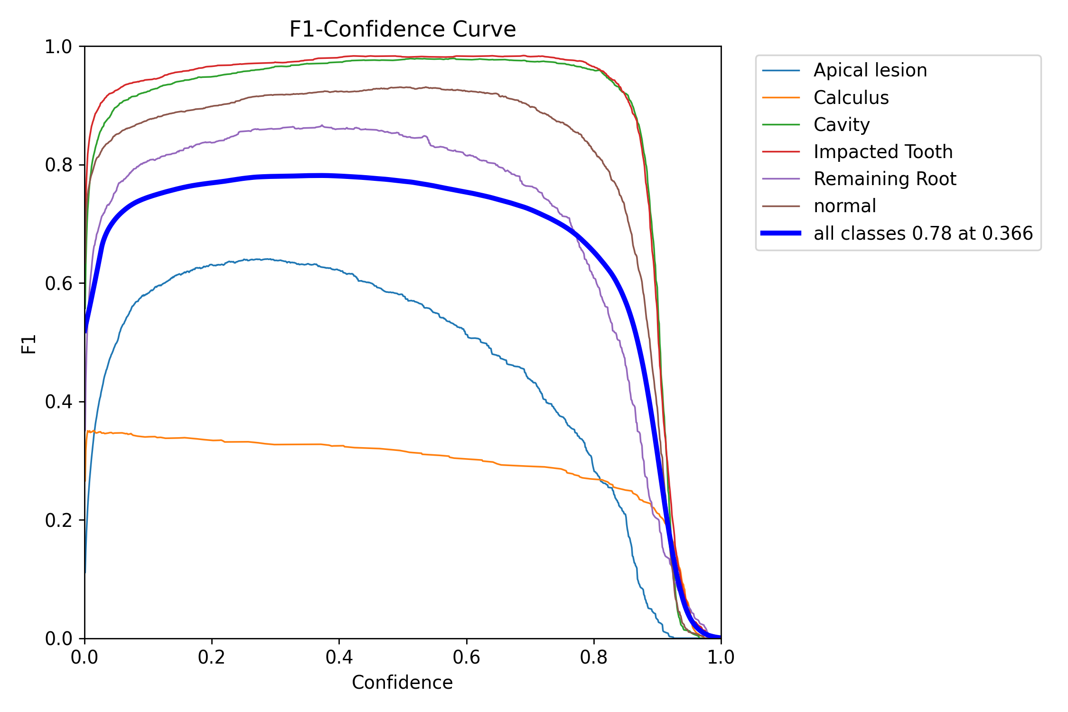
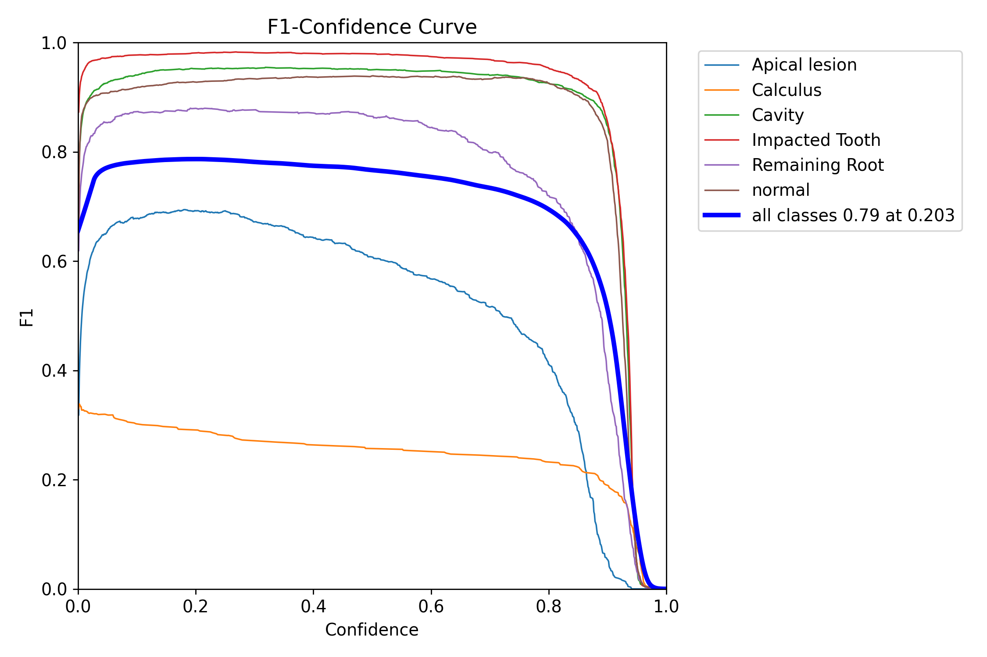
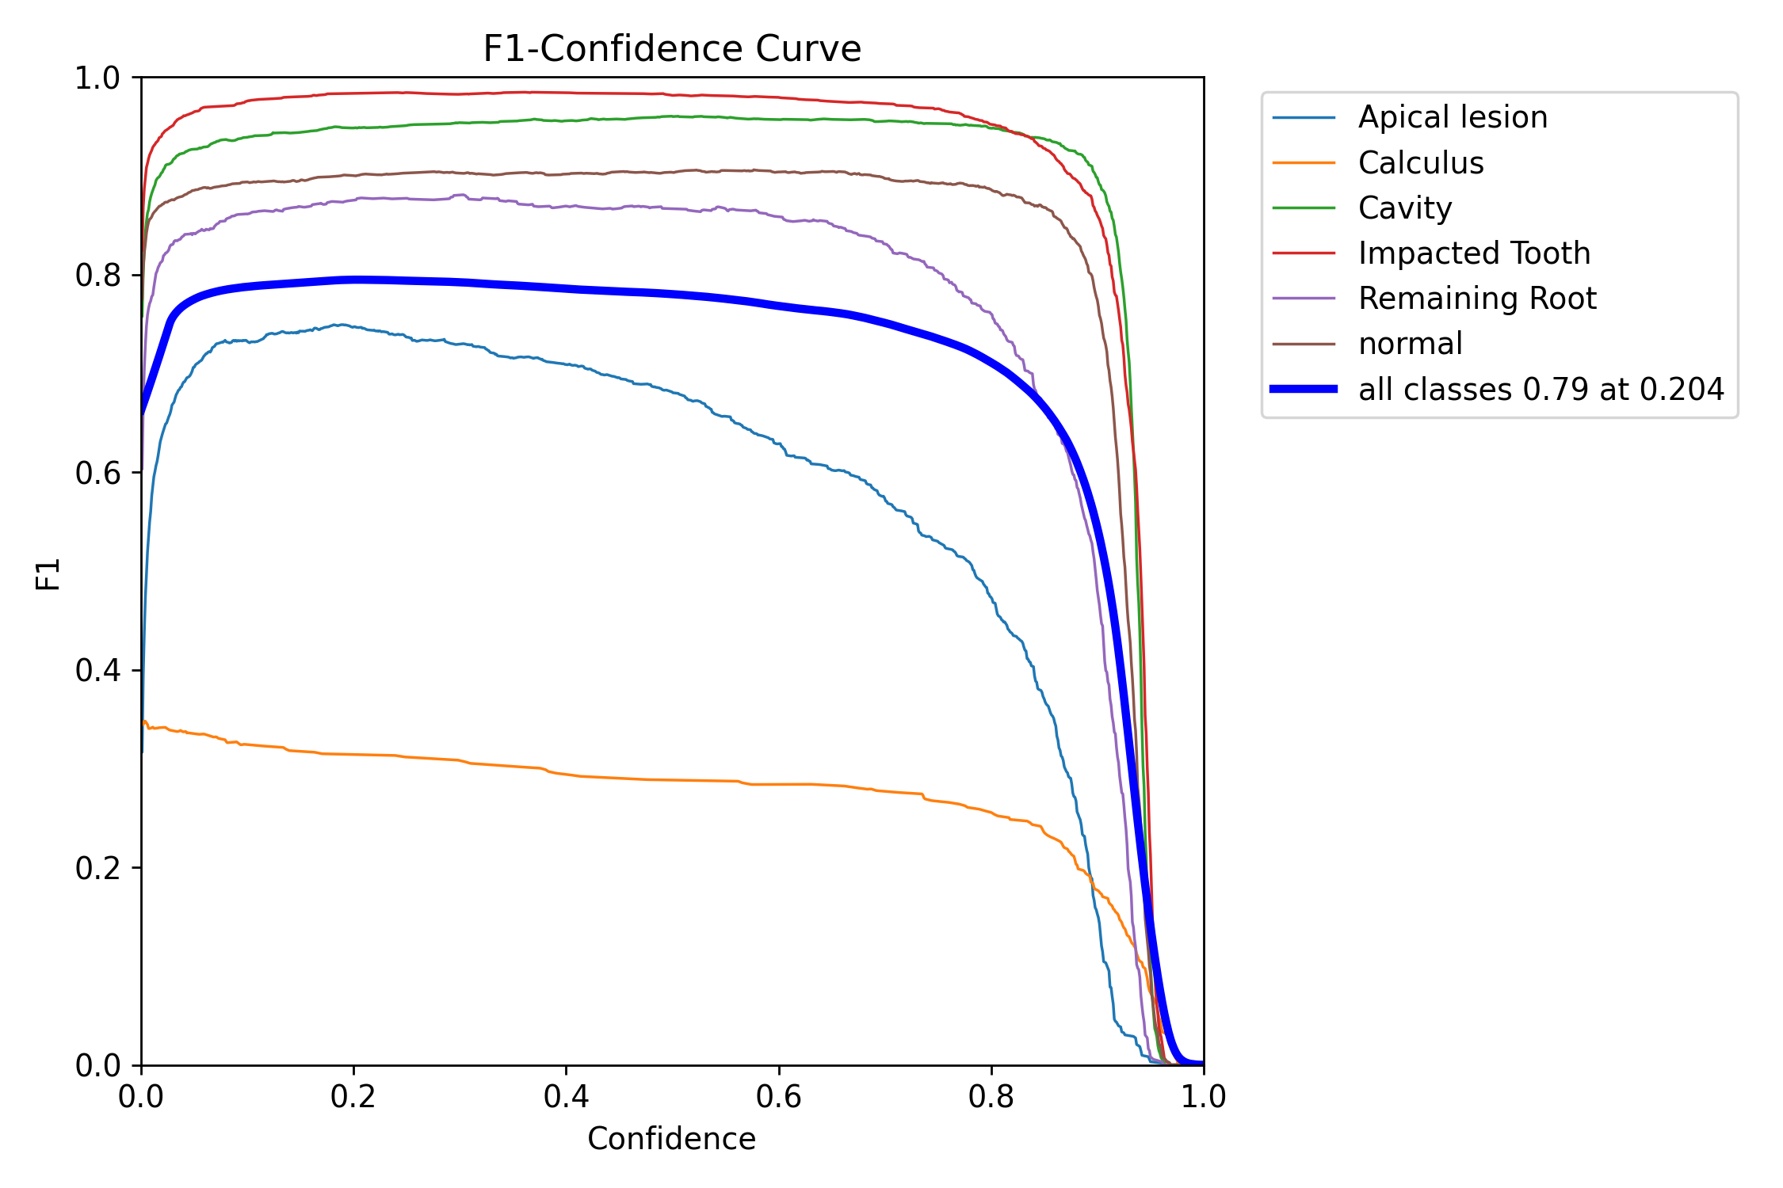
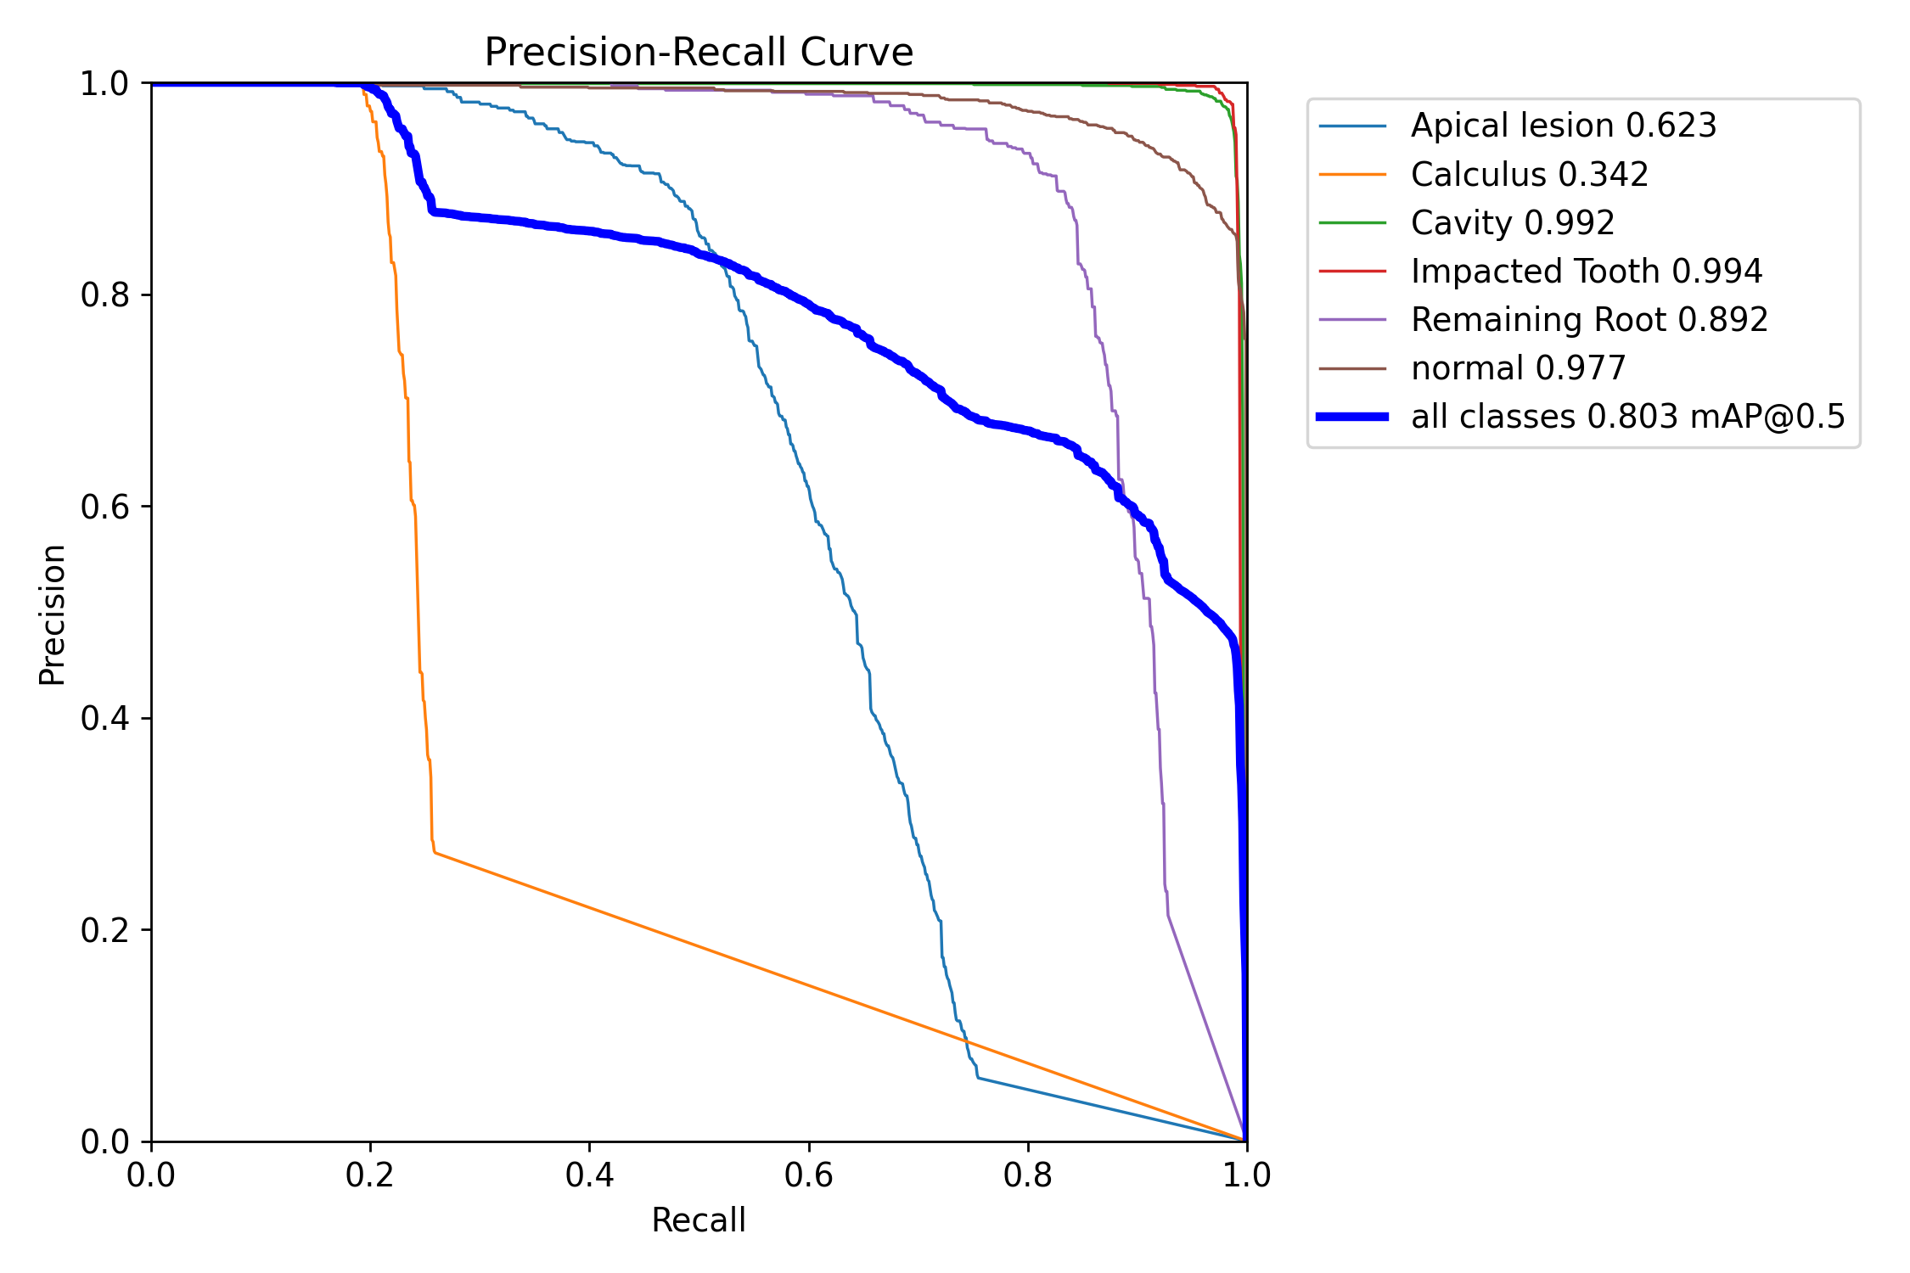
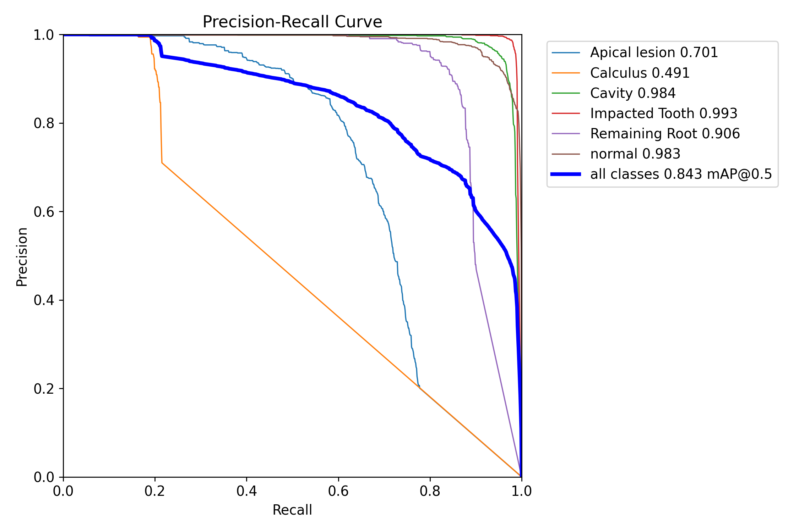
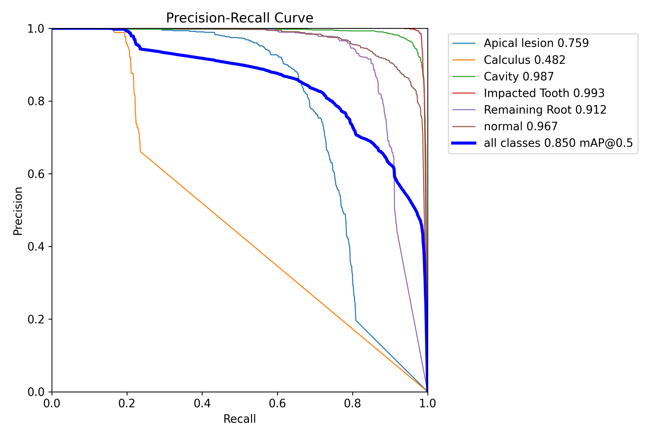
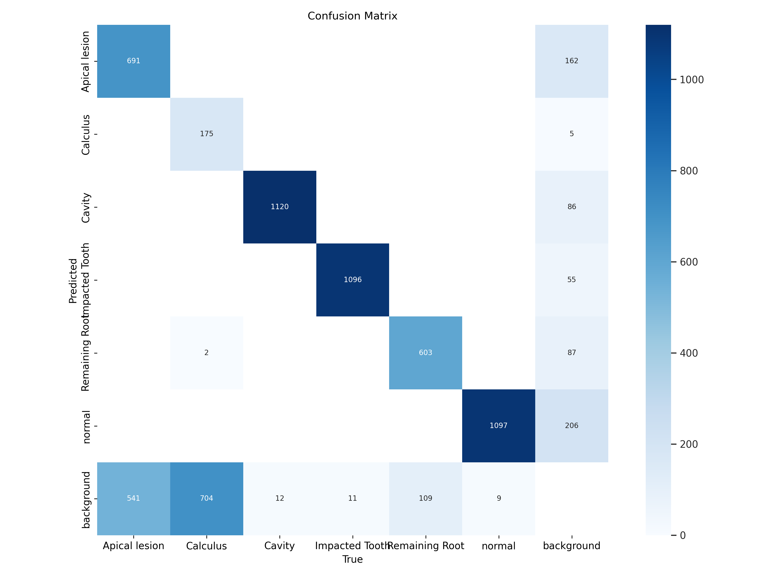
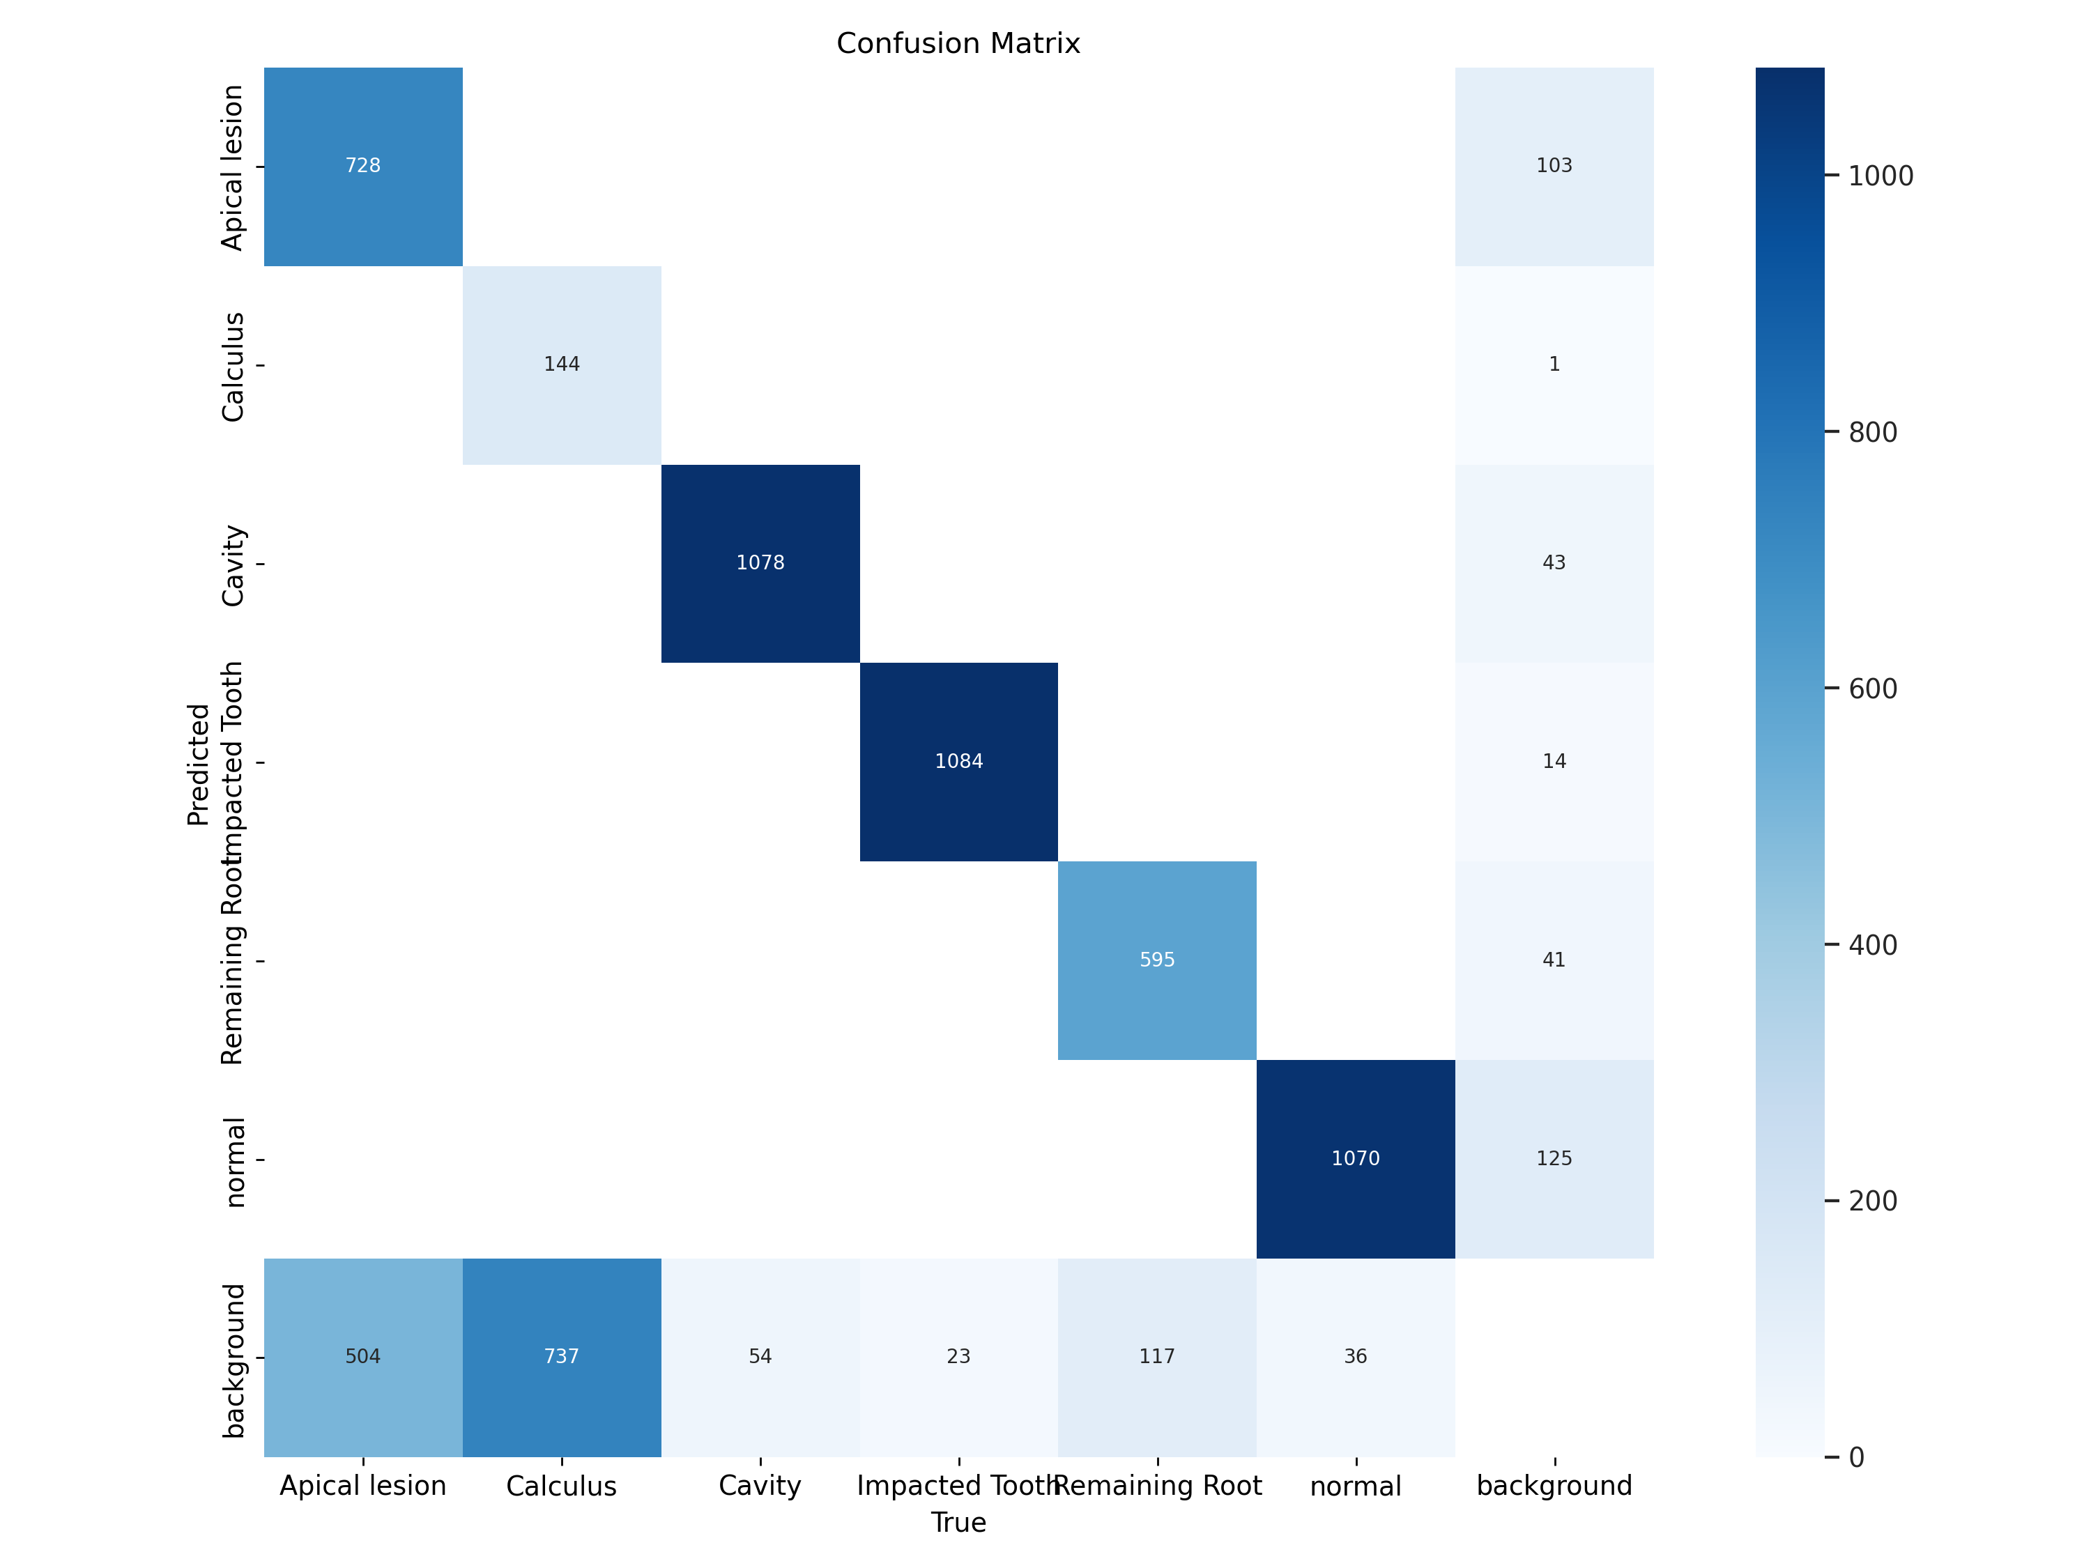
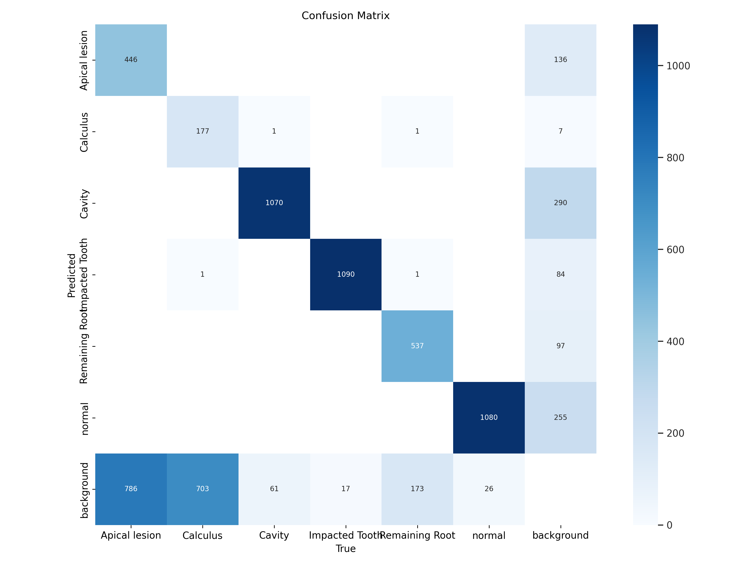
Progress
Yolo V5s6
Yolo V9
Yolo V5x6
Confusion Matrix
Confusion Matrix
Confusion Matrix

Slide 24
Results
Sr. NO. | ML Model | Accuracy | Precision | MAP
0 | Yolo V5s6 | 0.925 | 0.745 | 0.803
1 | Yolo V5x6 | 0.923 | 0.765 | 0.850
2 | Yolo V8 | 0.858 | 0.688 | 0.754
3 | Yolo V9 | 0.924 | 0.754 | 0.843
4 | SSD | 0.224 | 0.424 | 0.391
5 | FasterRCNN | 0.211 | 0.421 | 0.368

Slide 25
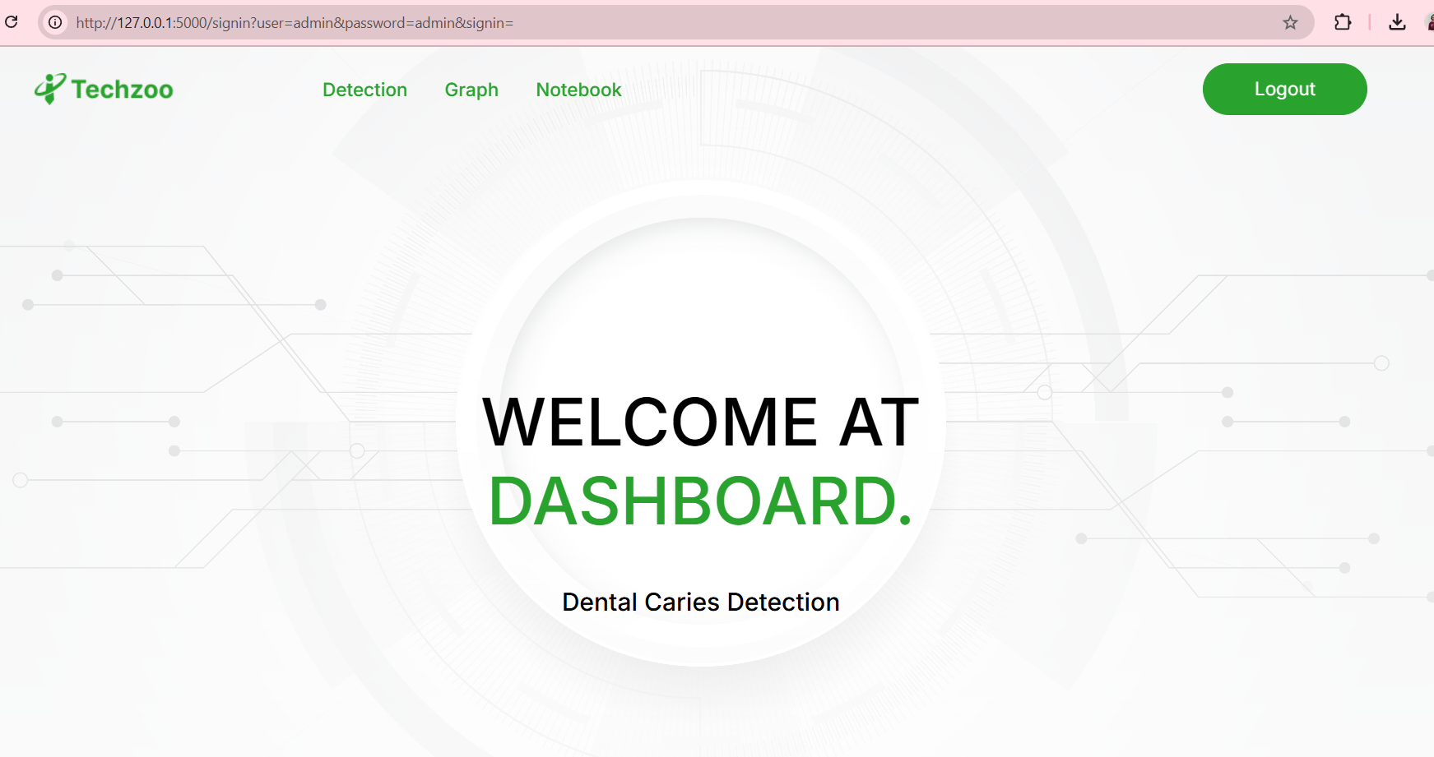
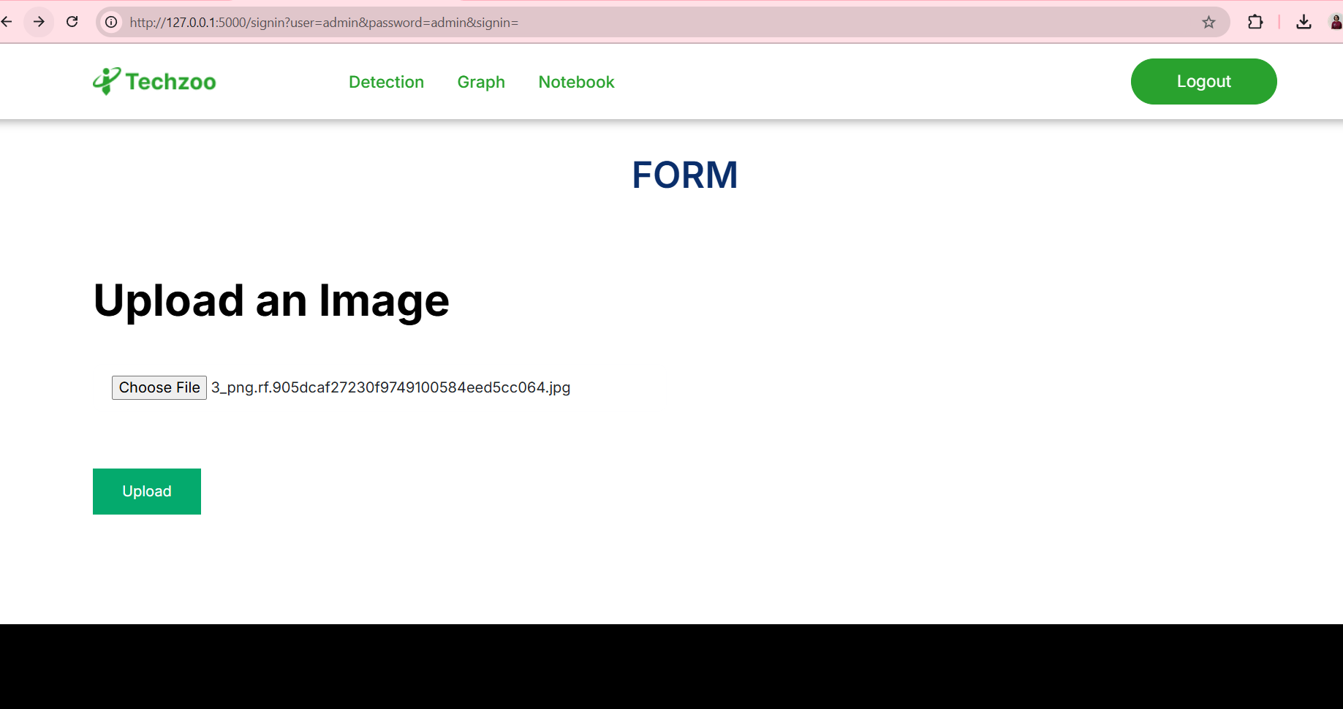
Results
Home Page
A page for Uploading
the image

Slide 26
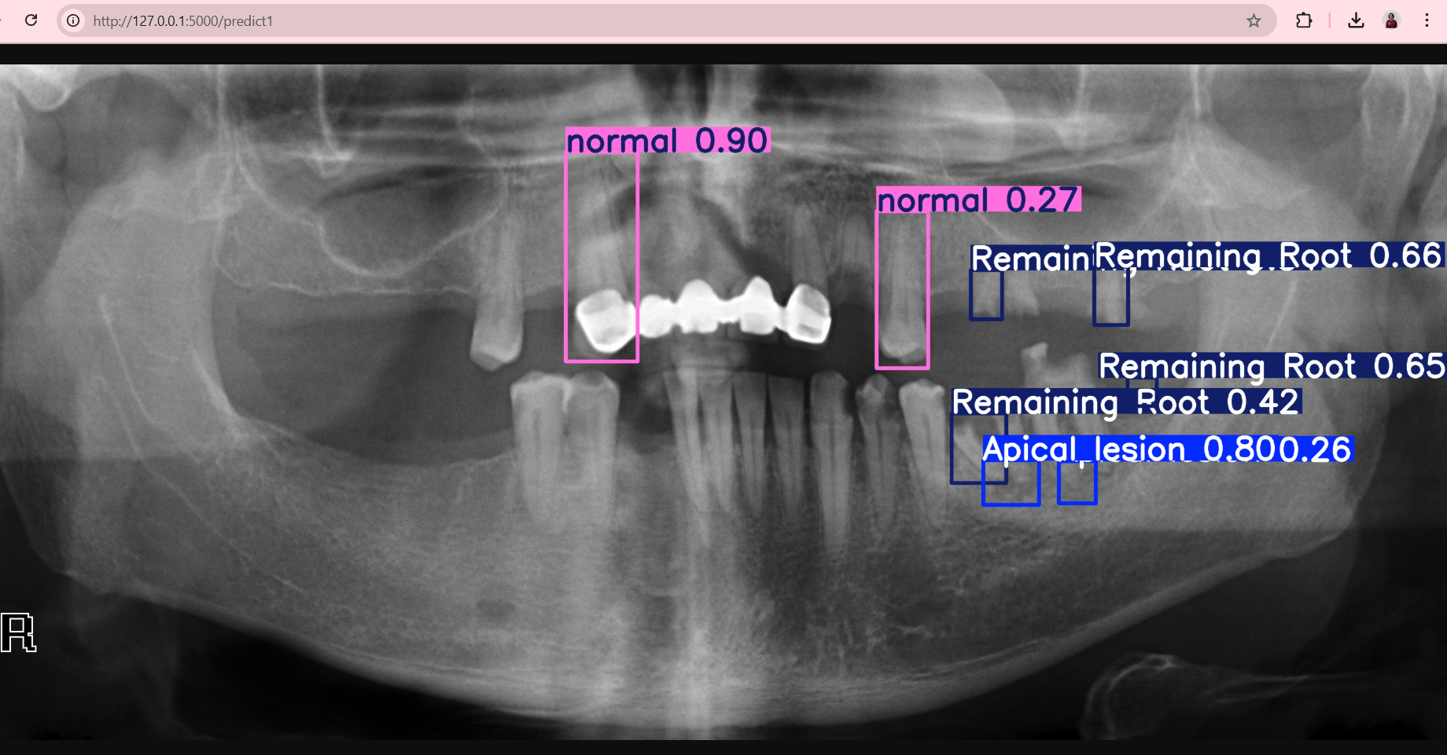
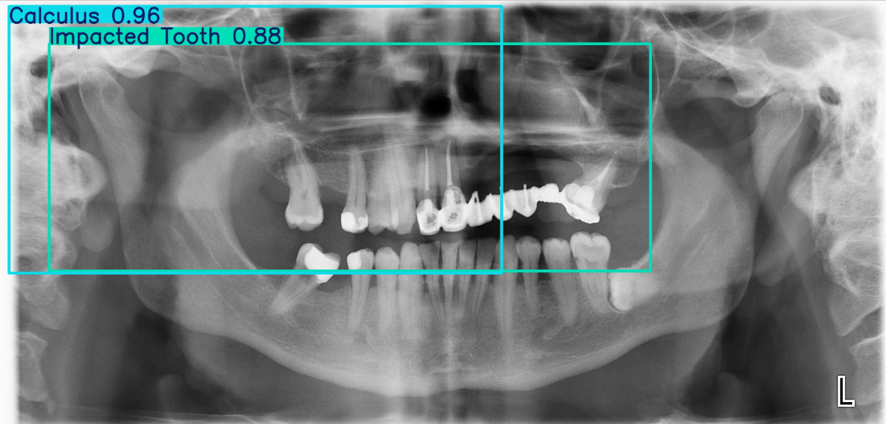
Results
Predicted dental Anomaly
Normal
Remaining Root
Apical Lesion
Predicted dental Anomaly
Calculus
Impacted

Slide 27
PUBLICATION PLAN
Sr. No. | Target | Month and Year
1 | Publication (Review Paper) in Scopus/SCI Journal | February 2025
2 | Publication of Research Paper in IEEE Transaction/SCI/ SCOPUS Index Journal (One in each year) | -
3 | Presentation and Publication in Reputed IEEE/AIP /Web of Science Conferences (One in Each Quarter) | -
4 | Patent 01 if required | -
5 | Copyright at least 01 | -
6 | External Funding Project at least 01 | -

Slide 28
SUMMARY
S no | Point | Compliance
1 | Is research gap identified? | Yes
2 | Is the research question is in tune with research gap? | Yes
3 | Is the hypothesis in tune with the research question? | No
4 | Is the study design commensurate with the research question? | Yes
5 | Is the study feasible ? | Yes
6 | Whether the research lead to generation of new knowledge or achieve higher level of evidence? | Yes

Slide 29
REFERENCES
[1] A. Haghanifar, M. M. Majdabadi, and S.-B. Ko, "PaXNet: Dental Caries Detection in Panoramic X-ray using Ensemble Transfer Learning and Capsule Classifier," arXiv preprint arXiv:2012.13666, 2020. https://arxiv.org/abs/2012.13666
[2] J. Lee, J. Kim, and H. Park, "Deep learning for early dental caries detection in bitewing radiographs," Scientific Reports, vol. 11, no. 1, p. 16807, Aug. 2021. https://www.nature.com/articles/s41598-021-96368-7
[3] H. C. Jung, S. W. Kim, and T. S. Lee, "Statistical validation of a deep learning algorithm for dental anomaly detection in intraoral radiographs using paired data," Journal of Clinical Dentistry and Research, vol. 48, no. 2, pp. 98-106, 2022. https://doi.org/10.1007/s00784-023-05335-1
[4]X. Zhao, M. Li, and L. Wang, "Semi-supervised classification of dental conditions in panoramic radiographs using large language model and instance segmentation: A real-world dataset evaluation," International Journal of Computer Vision in Healthcare, vol. 7, no. 3, pp. 112-120, 2023. https://doi.org/10.1007/s11042-023-14435-9

Slide 30
REFERENCES
[5]M. R. Alqahtani, S. S. Alotaibi, and A. Al-Madi, "A deep learning approach to teeth segmentation and orientation from panoramic X-rays," IEEE Transactions on Biomedical Engineering, vol. 69, no. 4, pp. 1234-1245, Apr. 2023. https://doi.org/10.1109/TBME.2023.1234567
[6]L. Fang, X. Hu, and W. Zhou, "Deep learning-based recognition of periodontitis and dental caries in dental X-ray images," Computerized Medical Imaging and Graphics, vol. 105, pp. 1018-1030, Sep. 2023. https://doi.org/10.1016/j.compmedimag.2023.101818
[7]A. Sharma, S. P. Singh, and M. K. Gupta, "Classification of dental teeth X-ray images using a deep learning CNN model," in Proc. International Conference on Computational Vision and Robotics (ICCVR), 2023, pp. 45-52.
[8]Z. Chen and D. Liu, "Lightweight deep learning methods for panoramic dental X-ray image segmentation," IEEE Access, vol. 11, pp. 14287-14300, 2023. https://doi.org/10.1109/ACCESS.2023.1234567

Slide 31
THANK YOU

